Slide 1


Pure Awesomeness
By: Luca Koval

Slide 2

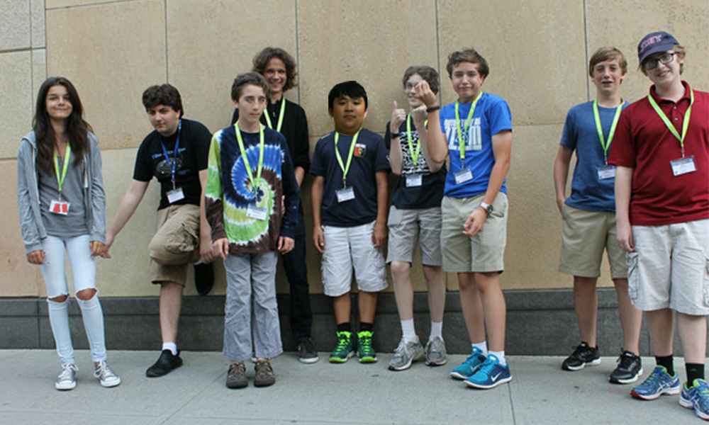
NYU
Group photo!
Programming 101
July 21th – August 1st

Slide 3

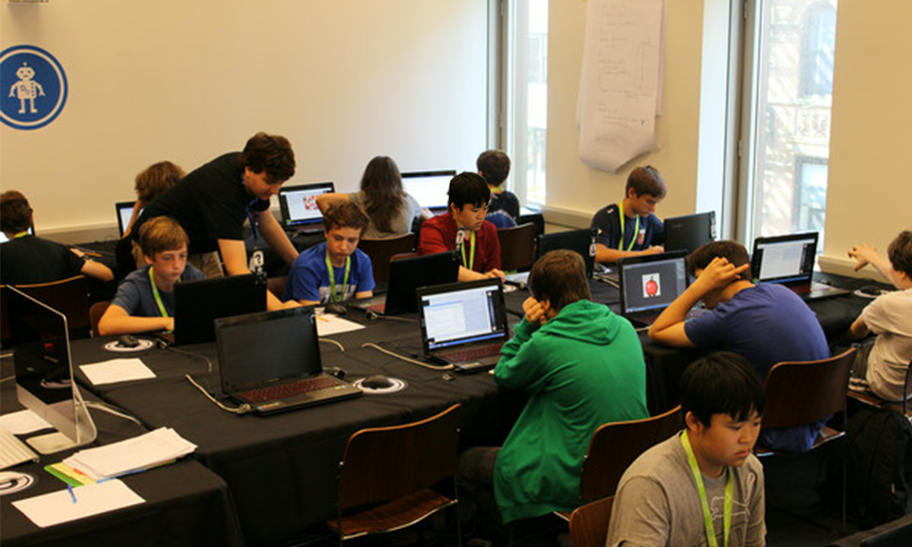
Java
It is very versatile.
It is one of the most popular and awesome computer languages out there.
You can create many awesome things.
Anything from text adventures to games with GUIs.
Coding in Java is fun!

Slide 4
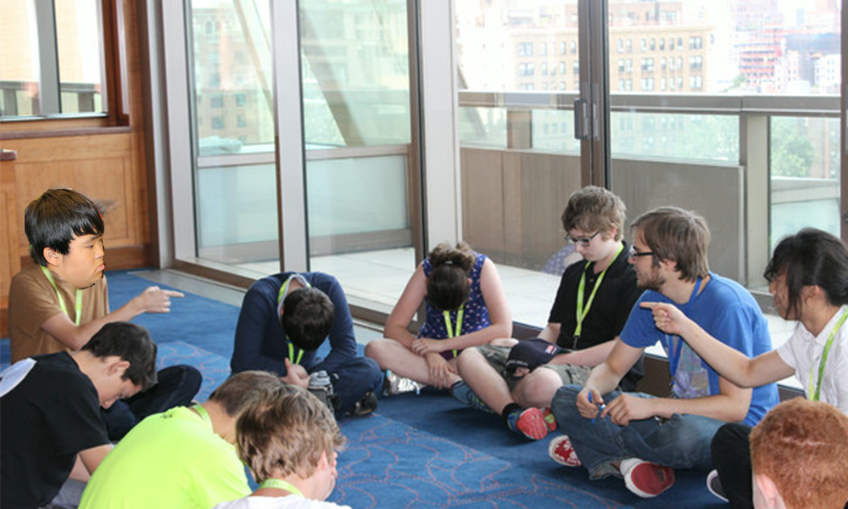
Eclipse
A Java compiler.
It takes the Java code that you type in, compiles it, and then runs it.
It is only for text and not for images.

Slide 5
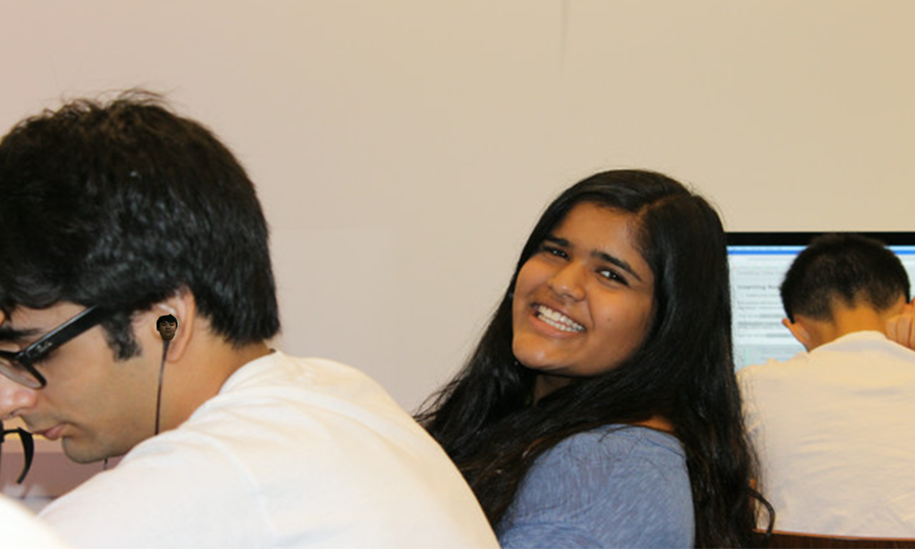
Greenfoot
Also a Java compiler.
But instead of dealing with just text, it also deals with images and graphics, or GUI: graphical user interface.

Slide 6
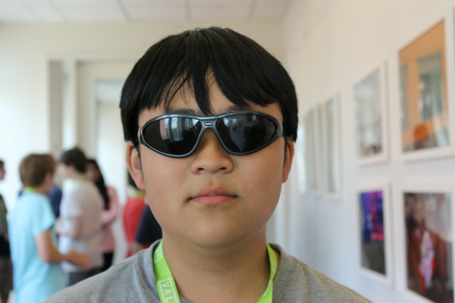
Object Oriented Programming (OOP)
It deals with object and classes.
It is very useful for many different things, such as games.

Slide 7
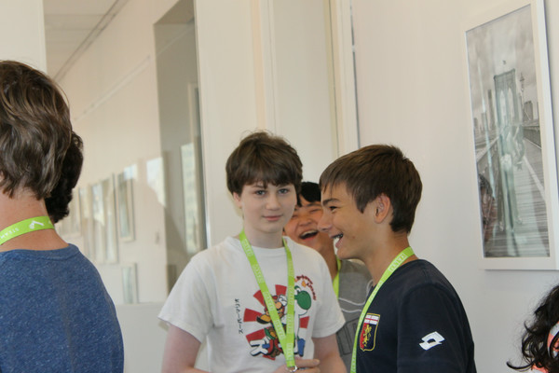
Favorite Camp Memory
My favorite camp memory was playing espionage.

